Slide 1
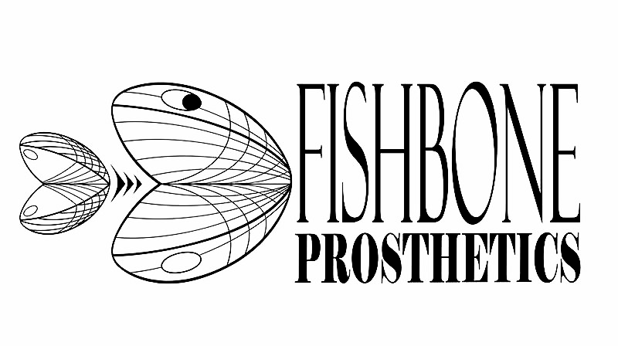
LIGHTWEIGHT PROSTHETIC FOREARM: A Press-fit Design
Sarah McBryan, UG
Dr. Jeffrey LaBelle, PhD

Slide 2
Heavy
Expensive
Limited
Patients abandon their devices due to weight
Current prosthetics are $30,000 to $100,000
Prosthesis with limited customization leave patients unsatisfied

Slide 3
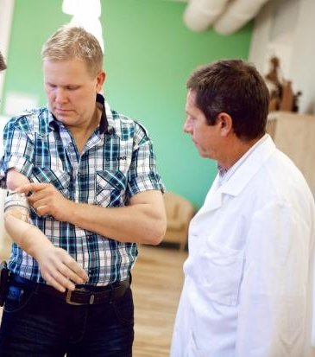
Practitioners
8,300
Patients
41,000
Notes:
Recent healthcare reforms have made it increasingly difficult to demonstrate patient need that justifies reimbursement for expensive myoelectric arms.
Fishbone Prosthetics innovative design allows us to dramatically decrease the cost of the device without a significant compromise in function

Slide 4
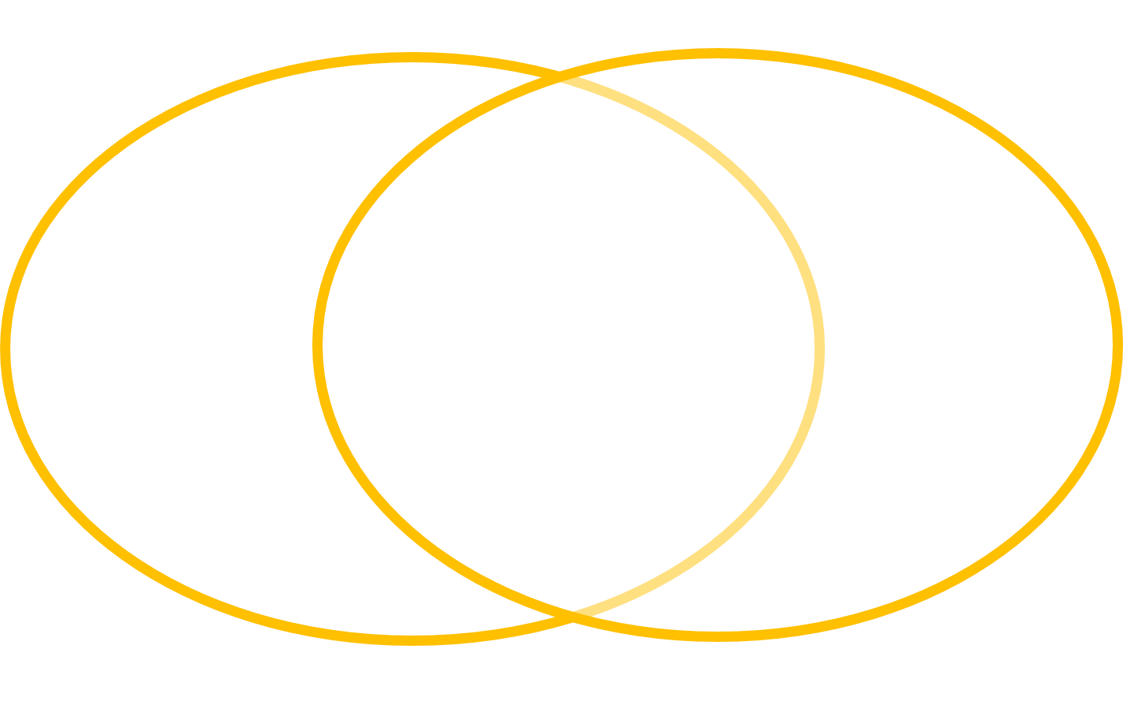

Value Proposition
Practitioner
- Less Wasted Time
- More
Patients
- Quick Delivery
- Increased Compliance
Patient
- Low Cost
- Lightweight
- Comfortable
Notes:
There are several reasons the practitioner will prescribe our device to the patient. Ultimately, their priority is to improve the quality of life for the patient, but we can’t forget that they are running a business too.
This means that Insurance providers will approve our device as the Least expensive appropriate option. The cost effective design will put an end to the cyclical denial / appeal battle currently plaguing the industry, and allow the practitioner to get our device to the patient 3-4 months faster.
The lightweight and comfortable design will discourage limb abandonment leading to an increase in patient compliance.
Our cost effective materials will allow us to bring prices down drastically without a considerable compromise in function

Slide 5
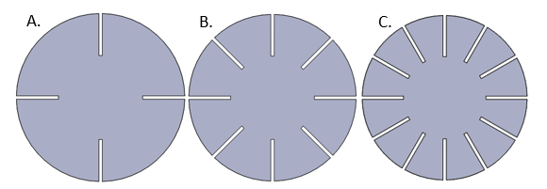
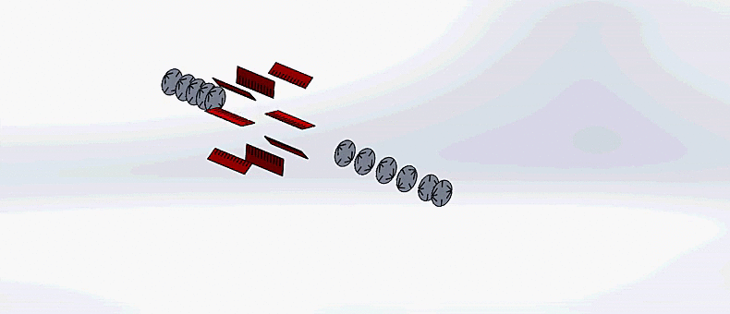
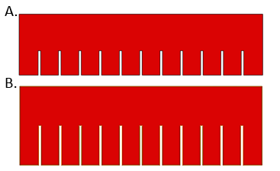
Press-fit Technologies
3D rigid structures made using 2D radial disks and linear fins interlocking together
No adhesives or hardware

Slide 6
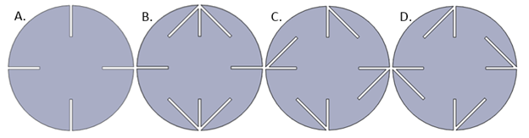
New disk geometry to optimize strength
Rigorous testing
Compression
Torsional
Interstitial free space
Varying fin type and number

Slide 7
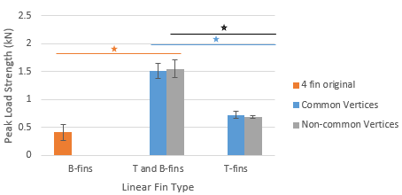
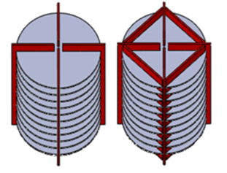
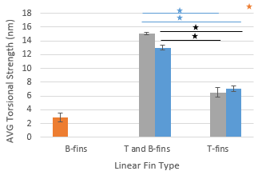
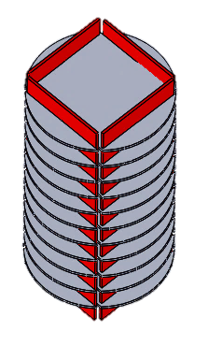
Technical Feasibility
Figure 1: Graphs of peak average compressive and torsional strengths, respectively

Slide 8
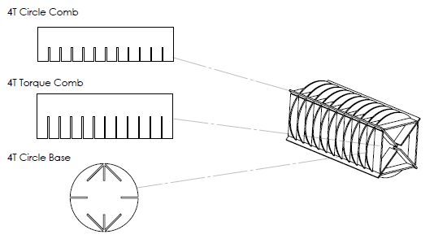
Press-fit Mechanical Frame
Low cost
Internal weight distribution
Lightweight
Strong
Patent pending for the Fishbone mechanical structure

Slide 9
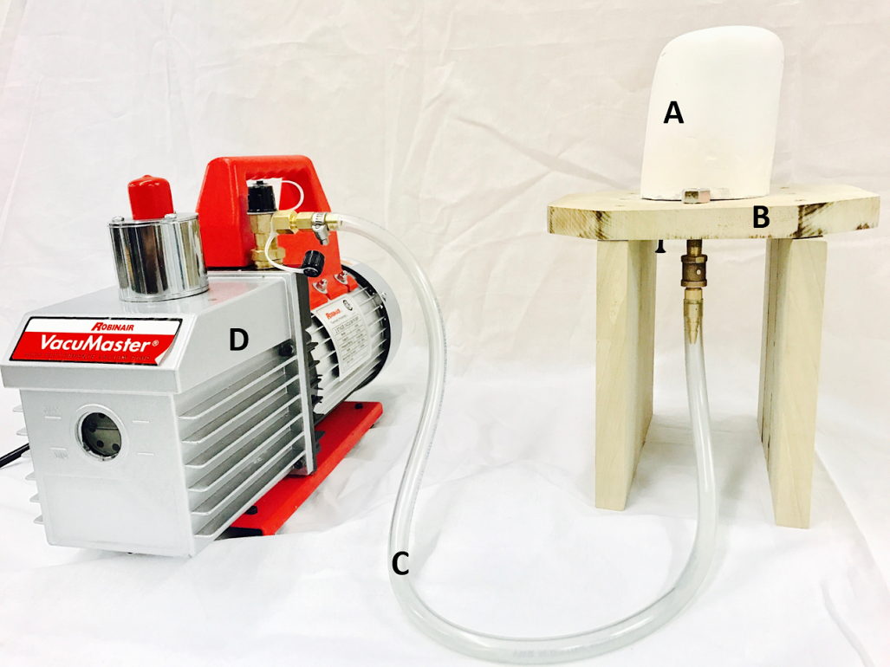
Continuing Research...
Project Fishbone is working to develop an entirely press-fit myoelectric prosthetic
Press-fit designs will be integrated with novel socket and nitinol actuators
Vacuum formed Socket
Increased Patient comfort
Biomimicry

Slide 10



fishboneprosthetics@gmail.com
Thank you,

